Slide 1
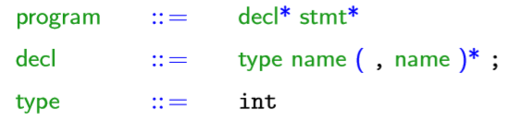
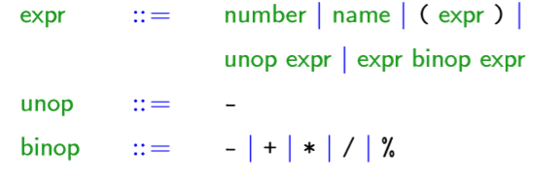
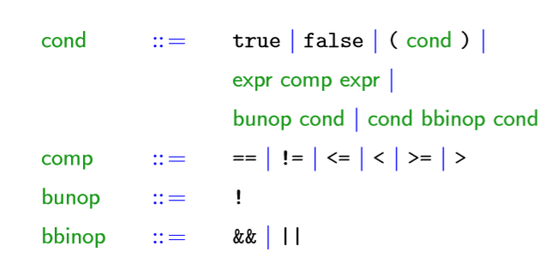
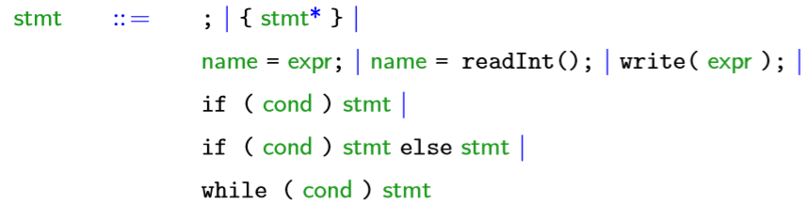

Slide 2
program
decl
decl
stmt
stmt
stmt
stmt
type
name
,
name
;
type
name
;
name
=
expr
;
name
=
expr
;
name
=
readInt()
;
while
(
cond
)
stmt
int
x
r
int
n
r
number
n
number
x
expr
comp
expr
1
1
name
<
name
n
x

Slide 3
stmt
{
stmt
stmt
stmt
}
if
(
cond
)
stmt
else
stmt
name
=
expr
;
write
(
expr
)
;
expr
comp
expr
name
=
expr
;
{
stmt
}
n
expr
binop
expr
name
expr
binop
expr
==
number
r
expr
binop
expr
name
=
expr
;
name
+
name
r
name
%
number
0
name
*
name
r
expr
binop
expr
n
1
name
*
(
expr
)
r
1
r
n
r
unop
expr
-
name
n

